Slide 1
Minneapolis Police Stops
Group F: James Curtis, Raleigh Love, Emanshu Patel, Erica Unterreiner

Slide 2
Motivation and Summary
Our project was to understand whether or not race, gender, time of day, and precinct correlate to police stops in Minneapolis.
For this analysis, police stops included traffic stops, suspicious person stops, and suspicious vehicle stops.
We asked our questions about these factors to evaluate the data for bias in treatment of people living and traveling through Minneapolis, which would have unfair negative consequences (legal, financial, personal, opportunity cost).

Slide 3
Research Questions
Are there proportional differences in race given the stops recorded by precinct?
Are there more stops during the morning, afternoon, evening or night time blocks?
What is the breakdown of police stops by race and gender?
What is the likelihood that the pre-race determination matched the actual race perceived after the stop?
We had difficulty answering these questions definitively due to limitations in data used.

Slide 4
Data Cleanup & Exploration
Describe the exploration and cleanup process
Read file into dataframe, observed N/A values
Discuss insights you had while exploring the data that you didn't anticipate
The accuracy of race identification
Discuss any problems that arose after exploring the data, and how you resolved them
To deal with N/A values, we reviewed data documentation
Splitting date timestamps into bins was difficult; used pd.Grouper
Notes:
read the file into a pandas data frame, observed n/a values.
Discuss insights you had while exploring the data that you did not anticipate:
accuracy of race identification
Discuss any problems that arose after exploring the data, and how you resolved them:
n/a values – researched through MN website; figuring out how to deal with date timestamps

Slide 5
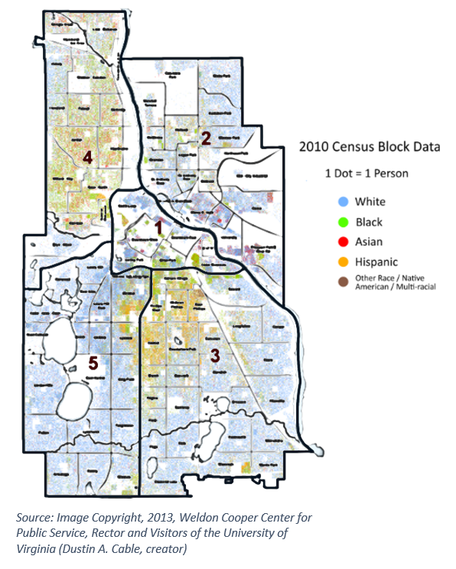
Data Exploration Overview

Slide 6
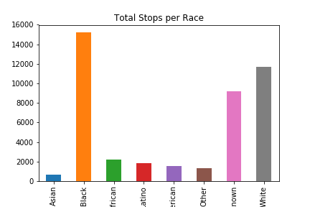
Data Exploration - Overview

Slide 7
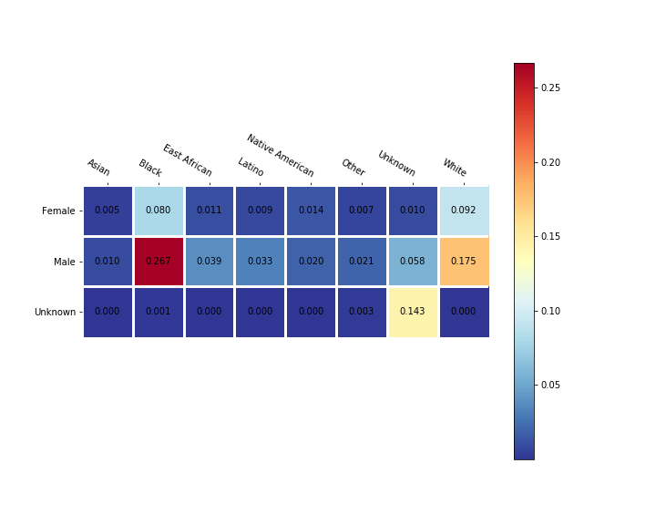
Data Exploration - Overview

Slide 8
Data Analysis
Gather relevant data from dataframes
Review plot visualizations for trends
Statistically analyze available data for strength of correlation
Draw conclusions if possible, and set limits/caveats for those conclusions based on logic and statistical correlation

Slide 9
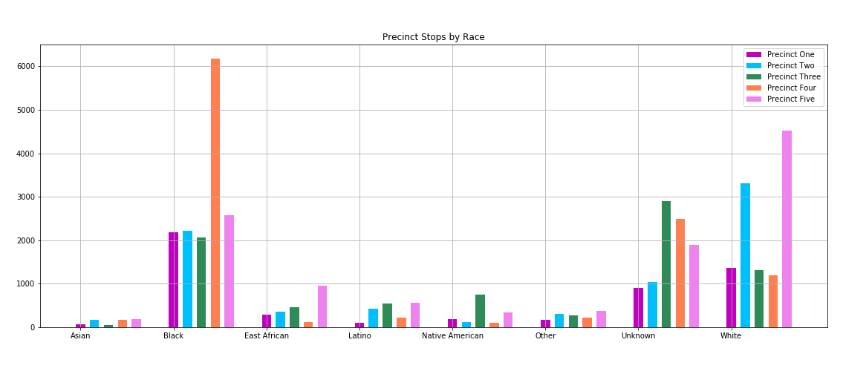
Data Analysis Are there proportional differences in race given the stops recorded by precinct?

Slide 10
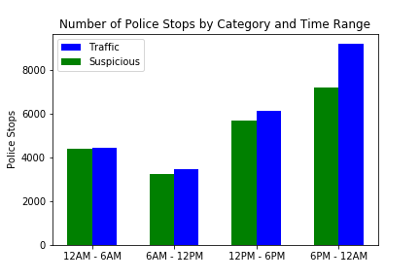
Data Analysis Are there more stops during the morning, afternoon, evening or night blocks?

Slide 11
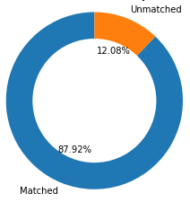
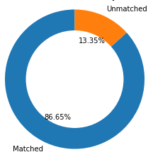
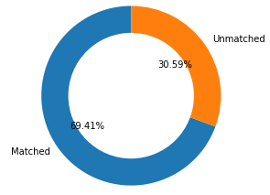
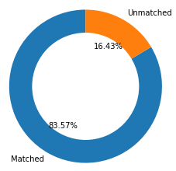

Data Analysis What is the likelihood that the pre-race determination matched the actual race perceived during the stop?
Precinct
1
Precinct
2
Precinct
3
Precinct
4
Precinct
5

Slide 12
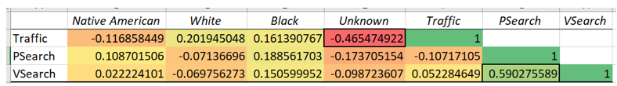
Statistical Analysis
Native Americans were slightly less likely to be involved in traffic stops.
Whites were more likely to be involved in traffic stops, but less likely to be searched.
Blacks were more likely to be in traffic stops and more likely to be searched.

Slide 13
Findings
Black males and white males were considerably more represented in police stops than any other race/gender combination.
Police stops were considerably more prevalent in the afternoon and evenings.
Pre-race and race matching was least accurate in Precinct 3, nearly by a factor of 2.
There was a large amount of police stops for black individuals in Precinct 4, by a factor of 2.
After performing our analysis of the data using tables, visualizations, and statistical analysis, we cannot confidently draw actionable information from these initial analyses based on the data we have. We know enough about the limitations of the current dataset to be cautious.

Slide 14
Post Mortem
Difficulties
Incorporating census data / timeframe of that data compared to our data set
Census data may not correlate to traffic stops given that not everyone who was stopped is a resident of the area where they were stopped
Data we used to answer our questions did not have sufficient statistical correlation to discard the null hypothesis
Additional Data/Questions
Measuring correlation between types of police stops and types of searches
Finding other data sources for a representative sample of driver demographics
Seeking to correlate more fine-grained geospatial information with points of interest data which might be related to types of police stops

Slide 15
Questions

